Slide 1
SOEN 6611 - Software Measurement
Credit Card Classification
Team 8
Akshay Dhabale - 40163636
Kshitij Yerande - 40194579
Mrinal Rai - 40193024
Siddhartha Jha- 40201472
Submitted to: Dr. Olga Ormandjieva

Slide 2
Establishing And Formalizing Measurement Goals
Business Goal
Analyze and improve the quality of big data for the purpose of classifying individuals into high risk or low risk category.
Measurement Goal
What is the vincularity of data?
Measurement Goal
What is the validity of data?
Measurement Goal
What is the veracity of data?
Operationalized goal
To evaluate the vincularity of data and analyze the trend and percent change between time frames
Operationalized goal
To evaluate the validity of data and analyze the trend and percent change between time frames
Operationalized goal
To evaluate the veracity of data and analyze the trend and percent change between time frames

Slide 3
Success Criteria And Indicators
Measure | Indicator | Success Criteria
Veracity | Mver for three time frames Percentage Change between time frame | Mver >=0.8 Percentage change < -5% (- represent direction of change)
Vincularity | Mvinc for three time frames Percentage Change between time frame | Mvinc >=0.6 Percentage change < -10% (- represent direction of change)
Validity | Mval for three time frames Percentage Change between time frame | Mval >= 0.9

Slide 4
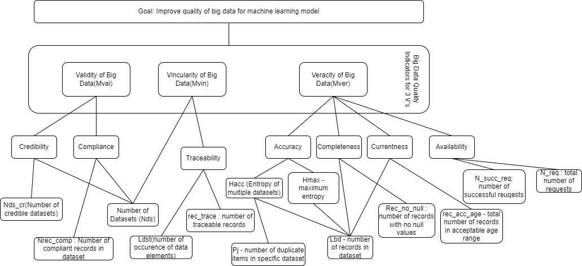
Measurement Hierarchy for Vincularity, Validity and Veracity

Slide 5
Planning the Measurement Process
Data Collection
Measuring Base Measures on raw data
Measuring Derived Measures on raw data
Data Processing
Measuring Base Measures on processed data
Measuring Derived Measures on processed data
Analyzing and interpreting results

Slide 6
Data Collection
Credit Card Classification Dataset
Source: https://www.kaggle.com/samuelcortinhas/credit-card-classification-clean-data
Column | Description | Value
ID | Unique identifier of the client | Unique number assigned to person
Gender | Gender of the person | 1 = Male 0=Female
Own_Car | Does the person own car | 1=Yes 0 =No
Own_Property | Does the person own property | 1=Yes 0 =No
Work_phone | Does the person have work phone | 1=Yes 0 =No
Phone | Does the person have personal phone | 1=Yes 0 =No
Email | Does the person have email ID | 1=Yes 0 =No
Unemployed | Is the person unemployed | 1=Yes 0 =No
Description: Credit cards are a popular risk management strategy in the financial sector. To estimate the likelihood of future defaults and credit card borrowing, it uses the personal information and data provided by credit card applicants.
Machine Learning Problem Statement:
To predict the whether an individual is at high credit risk or low credit risk.
General Information:
Numbers of rows: 9921
Number of columns : 20
Refer to report for details on additional column

Slide 7
Data Processing
Data processing was performed to clean data. Following operation were performed to clean data:
Remove records with null values
Remove duplicate records
Remove records where values does not adhere to column standards. E.g (alphabets in numeric columns, column value out of range)
Age column value was rounded to integer as age is supposed to be a integer value.
Issue | Value
Number of null records in data set | Gender 16 Own_car 16 Own_property 16 Work_phone 44 Phone 20 Email 16 Unemployed 16 Num_children 16 Num_family 44 Account_length 16 Total_income 16 Age 16 Years_employed 16 Income_type 16 Education_type 16 Family_status 16 Housing_type 16 Occupation_type 16 Target 16 Date 16
Number of duplicate records | 11
Columns which does not have acceptable values | Gender: 8 Work Phone: 13 Phone: 124 Unemployed: 135 Target: 144

Slide 8
Calculating Base Measures
Measure | Description | Value - Before Processing | Value After Processing
Nds | Number of Dataset | 1 | 1
Nds_cr | Number of credible dataset | 1 | 1
Nrec_comp | Number of compliant records | 9756 | 9745
Rec_trace | number of traceable records | 9756 | 9745
Ldst | total number of records | 9920 | 9745
Lbd | total number of records | 9920 | 9745
Rec_acc_age | number of records within acceptable time range | 4957 | 4880
N_succ_req | number of successful requests | 1 | 1
N_req | number of requests | 1 | 1
rec_no_null | number of records with no null values | 9852 | 9745
P(j) | number of duplicate records in dataset | 11 | 0

Slide 9
Calculating Derived Measures
Measure | Value before processing | Value after processing
Accuracy | 0.99 | 1
Completeness | 0.99 | 1
Currentness | 0.49 | 0.50
Availability | 0.83 | 0.89
Traceability | 0.98 | 1
Compliance | 1 | 1
Credibility | 0.98 | 1
Note: Values above are the average over timeframe.

Slide 10
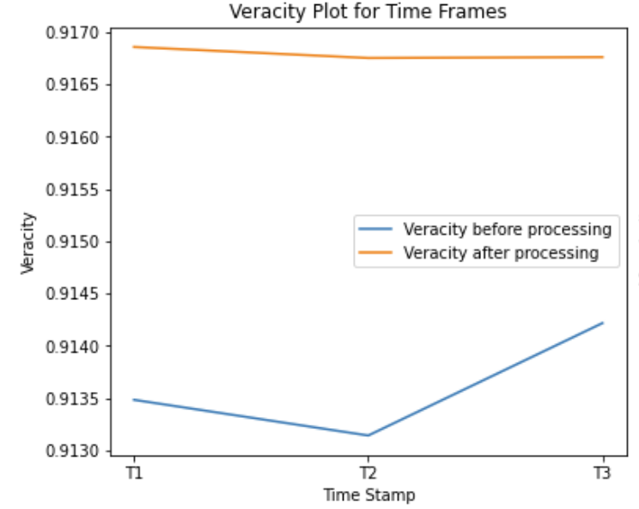
Results- Veracity
Veracity before processing and after processing is above the acceptable threshold >= 0.8
Average Veracity after processing has increased slightly by 0.35% signifying improvement.
Percentage change between time frame t2-t3 is positive meaning more accurate, complete records are added to dataset.
Veracity
T1(before) | T2(before) | T3(before) | Average | T1(after) | T2(after) | T3(after) | Average
0.9134 | 0.9132 | 0.9142 | 0.9136 | 0.9168 | 0.9167 | 0.9167 | 0.9167
% Change
T1 - T2(Before) | T1-T3(Before) | T2-T3(Before) | T1-T2(After) | T1-T3(After) | T2-T3(After)
-0.04 | 0.08 | 0.12 | -0.01 | -0.01 | 0

Slide 11
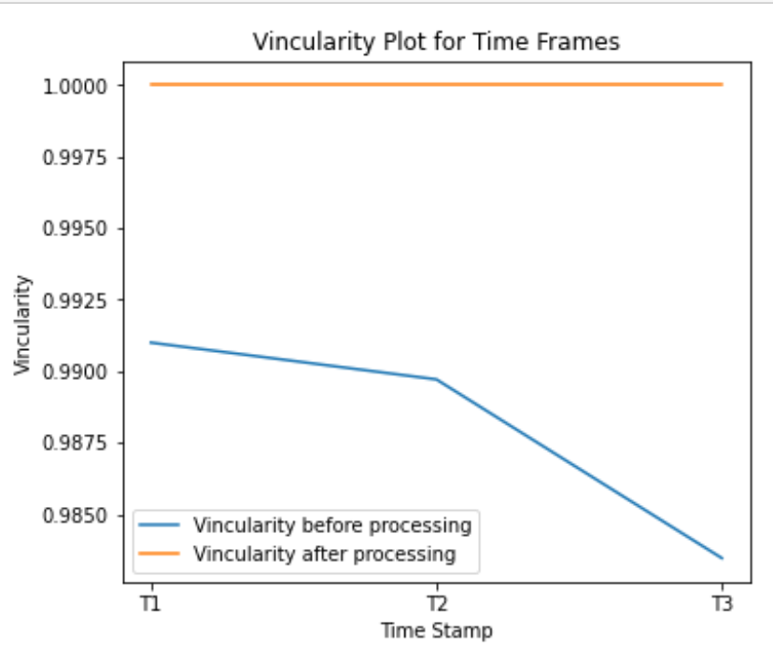
Results- Vincularity
Vincularity before processing and after processing is above the acceptable threshold >= 0.6
Average Vincularity after processing has increased slightly by 1.21% signifying some improvement.
Vincularity before processing is on a downward slope as new data is added however is well above the acceptable threshold and drop threshold.
Vincularity
T1(before) | T2(before) | T3(before) | Average | T1(after) | T2(after) | T3(after) | Average
0.991 | 0.9897 | 0.9834 | 0.9880 | 1 | 1 | 1 | 1
% Change
T1 - T2(Before) | T1-T3(Before) | T2-T3(Before) | T1-T2(After) | T1-T3(After) | T2-T3(After)
-0.13 | -0.76 | -0.63 | 0 | 0 | 0

Slide 12
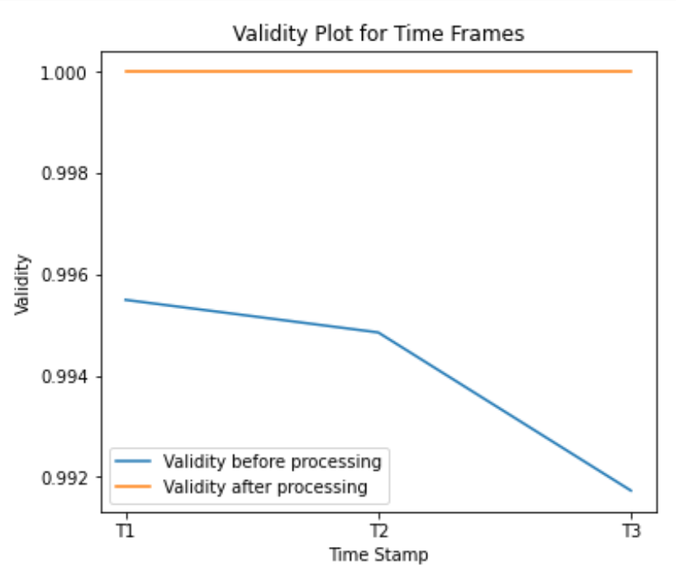
Results- Validity
Validity before processing and after processing is above the acceptable threshold >= 0.9
Average Validity after processing has increased slightly by 0.6% signifying some improvement.
Validity before processing dropped slightly in t2 - t3 time frame due increase in very few non compliant records.
Validity
T1(before) | T2(before) | T3(before) | Average | T1(after) | T2(after) | T3(after) | Average
0.9955 | 0.9948 | 0.9917 | 0.9940 | 1 | 1 | 1 | 1
% Change
T1 - T2(Before) | T1-T3(Before) | T2-T3(Before) | T1-T2(After) | T1-T3(After) | T2-T3(After)
-0,06 | -0.38 | -0.31 | 0 | 0 | 0

Slide 13
Lessons Learned
Good data quality helps strengthening the trust on the analysis results
Structured approach of measurement process makes things clear and stay on track
Learned to apply measurement process on a given problem.
Learned about new V’s (Vincularity, Validity and Veracity ) and how to measure them.
What could be changed to deliver better results?
Better planning of tasks and analysis of scope would have avoided last minute changes
Lack of work experience creates difficulty in understanding the issues faced when working with actual real-time data
What still puzzles us?
How Quality measurement procedures work in parallel with SDLC

Slide 14
Thank You

